Slide 1

CS 499 Milestone One: Code Review
AI Coloring Book Generator
Fiorella Sierra Berrocal
Southern New Hampshire University
CS 499
Notes:
Hello, my name is Fiorella, and for my CS 499 code review I will be reviewing my AI Coloring Book Generator. I will evaluate the project in three areas: software engineering and design, algorithms and data structures, and databases. I will discuss the current functionality, identify areas for improvement, and explain the enhancements I plan to make.

Slide 2

AI Coloring Book Generator
Python/React full-stack application
AI coloring-page generation
User accounts and authentication
Credit tracking
Saved image library
Database persistence
Multiple application components
Notes:
My artifact is a full-stack AI Coloring Book Generator. The project contains a backend API, frontend interface, and shared Python image-generation code. The application supports user accounts, AI image generation, credit tracking, and a library for previously generated pages. For this review, I will focus on specific portions of the code that demonstrate the three required computer science categories.

Slide 3
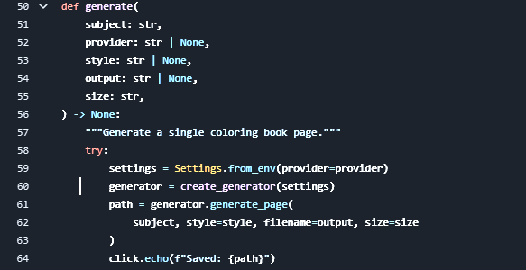
Software Engineering and Design
Receives subject, provider, style, output, and size
Loads configuration settings
Creates the selected AI generator
Calls generate_page()
Returns the saved file path
Notes:
For software engineering and design, I am starting with the generate function in the cli.py module. This function receives the user's subject along with optional settings such as the provider, style, output filename, and image size. The function then loads the application's configuration using Settings.from_env. Next, create_generator creates the appropriate AI generator based on those settings. The generate_page method receives the user's options and generates the coloring page. Finally, the program displays the location where the generated page was saved.

Slide 4

Software Engineering Analysis
Analysis
Strengths
Input validation
Exception handling
Commands have defined responsibilities
Weakness
Error-handling logic is duplicated
CLI also coordinates application workflow
Notes:
One strength is that the application already performs input validation and exception handling. However, the same exception-handling logic appears in multiple commands. The CLI is also responsible for both user interaction and coordinating parts of the generation workflow. This creates duplication and makes the CLI responsible for more than one concern.

Slide 5
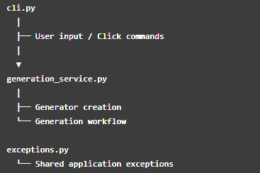
Planned Software Engineering Enhancement
Specific Enhancement
cli.py → CLI interaction only
generation_service.py → generation workflow
exceptions.py → centralized application exceptions
config.py → configuration/provider settings
Notes:
My enhancement will separate these responsibilities into specific modules. cli.py will remain responsible for command-line interaction and collecting user input. I plan to create generation_service.py to handle generator creation and the generation workflow. Application-specific exception handling will be centralized through an exceptions.py module, while config.py will continue managing configuration and provider settings. This refactoring will reduce duplication and improve separation of concerns, maintainability, and testability.

Slide 6
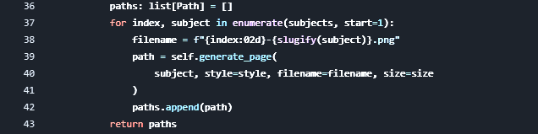
Algorithms and Data Structures
Current Algorithm
Input: list[str] of subjects
Iterates sequentially
Generates unique filenames
Calls generate_page()
Stores paths in list[Path]
Preserves page order
Notes:
For algorithms and data structures, I reviewed the generate_book method in base.py. The method receives a list of subjects and processes each subject sequentially. enumerate supplies the page number, while slugify helps create a filename. Each generated path is appended to a list, and that ordered list is returned when processing is complete.

Slide 7

Algorithms and Data Structures Analysis
Analysis
Strengths
Simple ordered list
Predictable processing
Easy to understand
Limitation
One generation failure can interrupt the loop
Only successful paths are represented
Failure information isn't tracked here
Notes:
The current algorithm is simple and appropriate for maintaining page order. However, generate_page is called directly inside the loop without individual exception handling. If one page raises an exception, the remaining subjects may not be processed. The current paths list also only represents successfully returned paths and provides no structure for recording which subject failed or why.

Slide 8
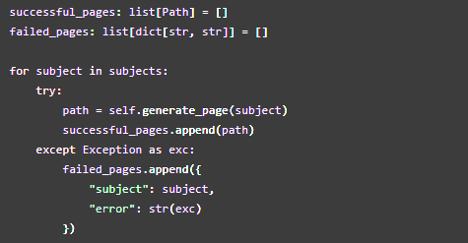
Proposed Enhancement
Successful paths → ordered list
Failures → subject + error information
Individual failure does not stop remaining pages
Notes:
My enhancement will explicitly track both successful and failed page generations. Successful file paths will remain in an ordered list called successful_pages. Failed attempts will be stored separately in failed_pages, where each entry records the subject and associated error message. Exception handling will occur within the processing loop, allowing the application to continue attempting the remaining pages when an individual generation fails.

Slide 9
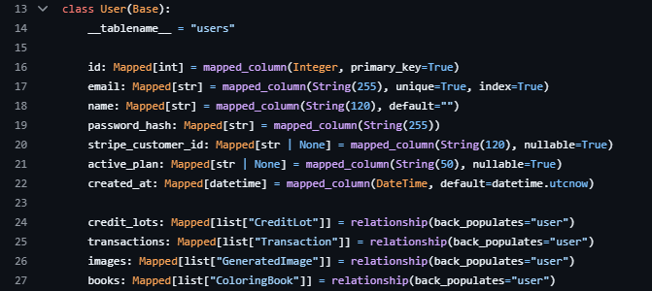
Databases
Current Database Design
SQLAlchemy ORM
Primary keys
Foreign-key relationships
Unique user email
Indexed email
Relationships between users, books and images
Notes:
For the database category, I reviewed the SQLAlchemy models. The User model demonstrates several existing database-design practices. The user ID is a primary key, while email is both unique and indexed. SQLAlchemy relationships associate users with generated images, coloring books, credit lots, and transactions.

Slide 10
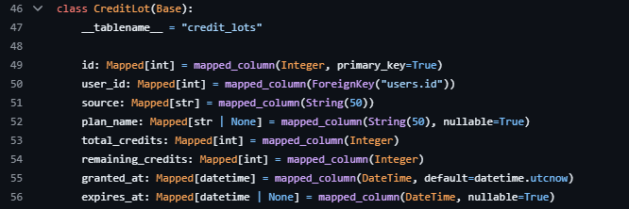
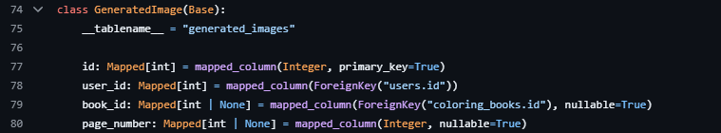
Database Code Analysis
Analysis
Relational structure is established
Foreign keys connect records
Nullable fields are explicitly defined
Some numeric fields lack database-level value constraints
Additional indexes could support common retrieval patterns
Notes:
The database already has a clear relational structure. GeneratedImage connects records to users and optionally to coloring books through foreign keys. However, some numeric fields, such as page counts and credit values, do not currently show database-level constraints preventing invalid negative values. I also identified fields involved in common relationships and retrieval operations that I can evaluate for additional indexing.

Slide 11



Planned Database Enhancement
Constraints
page_count >= 0
total_credits >= 0
remaining_credits >= 0
Index
GeneratedImage(user_id, created_at)
Existing
User.email remains unique + indexed
Notes:
My database enhancement will be more specific than simply adding validation. I plan to add check constraints that prevent values such as page_count, total_credits, and remaining_credits from becoming negative. I also plan to evaluate a composite index on GeneratedImage.user_id and created_at because the application maintains a library of previously generated pages. The existing User.email field already demonstrates uniqueness and indexing, so I will preserve that existing constraint.

Slide 12

Code Review Summary
Software Engineering
Separate CLI and service responsibilities
Algorithms & Data Structures
Track successful and failed generations
Databases
Add specific constraints and evaluate targeted indexes
Goal: reliability, maintainability, scalability
Notes:
Overall, this review identified three specific enhancement areas. For software engineering, I will separate CLI responsibilities from the generation workflow. For algorithms and data structures, I will improve the book-generation algorithm by tracking successful and failed page generations independently. For databases, I will add specific integrity constraints and evaluate targeted indexing. Together, these enhancements will demonstrate my ability to analyze an existing application and make purposeful improvements to its design, algorithms, and data management.

